Slide 1

Andrés Villegas¹ Joint work with: Madhavi Bajekal² Steve Haberman¹ ¹Cass Business School, City University London ²Department of Applied Health Research, University College London
Mortality modelling in R: an analysis of mortality trends by cause of death and socio-economic circumstances in England
R in Insurance
July 15th, 2013 Cass Business School London

Slide 2
Agenda
Motivation
Modelling mortality in R
Modelling mortality by CoD and socio-economic stratification
Case study: Mortality by deprivation in England
Conclusions

Slide 3
Motivation Socio-economic differences in mortality
Male life expectancy at age 65 by social class -England and Wales
Well-documented relationship between mortality and socioeconomic variables
Education
Income
Occupation
Important implications on social and financial planning
…
Public policy for tackling inequalities
Longevity risk management
…
Source: ONS Longitudinal Study

Slide 4
Motivation Cause-specific mortality
Forecasts of cause-specific mortality required for many purposes
E.g Estimation of health care costs
Inform the assumptions underlying overall mortality projections
Shed light on the drivers of mortality
Mortality change
Mortality differentials

Slide 5
Motivation Why use R?
Flexible tools for analysing mortality data and fitting mortality models
Very good tools for presenting and communicating methods and results
R is free

Slide 6
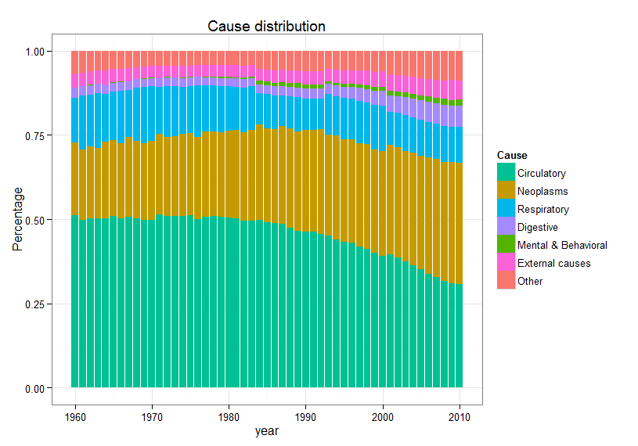
Causes of mortality in England and Wales Causes distribution in time (ASDR males age 25-84)
R tip
Graphs made using package ggplot2. It makes it easy to control details (e.g legends, colours)

Slide 7
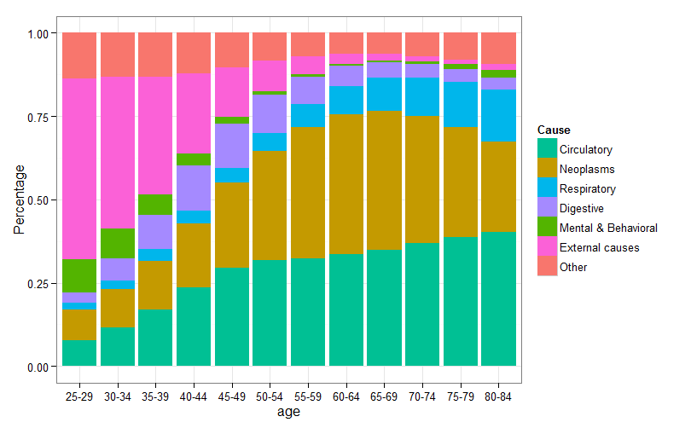
Causes of mortality in England and Wales Causes distribution by age (males 2001-2010)
R tip
Graphs produced using geometry geom_bar from package ggplot2

Slide 8
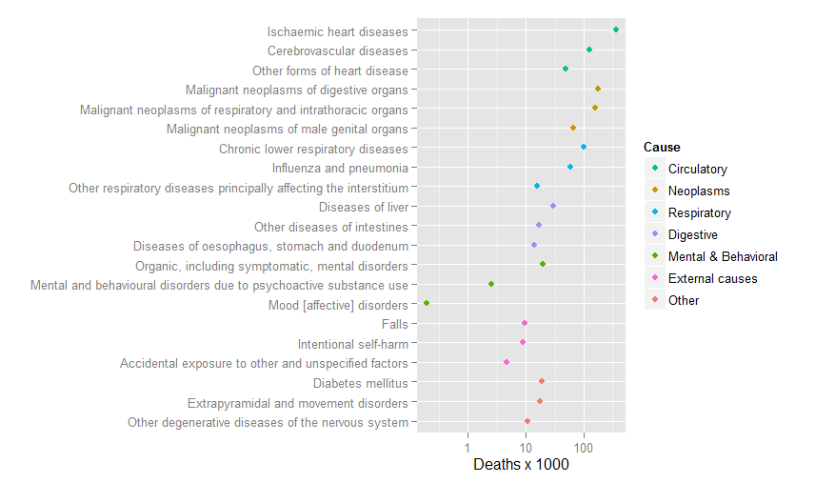
Causes of mortality in England and Wales Main causes for males aged 50-84 (2001-2010)
R tip
Graphs produced using geometry geom_point from package ggplot2

Slide 9
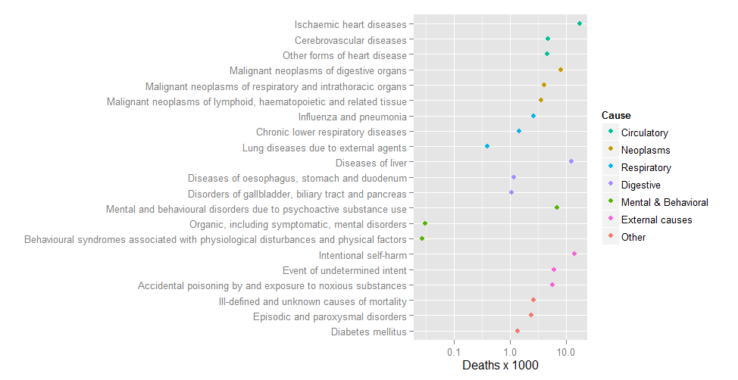
Causes of mortality in England and Wales Main causes for males aged 25-49 (2001-2010)
R tip
Graphs produced using geometry geom_point from package ggplot2

Slide 10
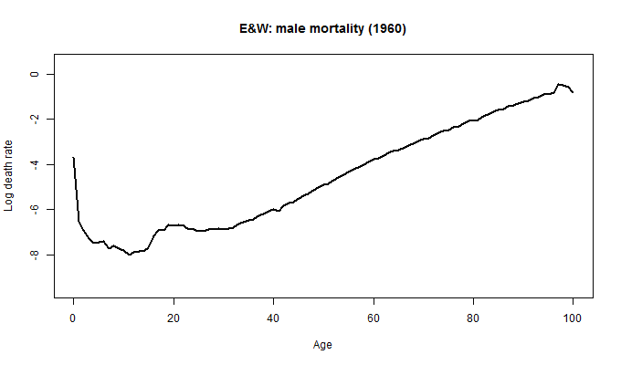
Modelling mortality Lee-Carter model
R tip
Use function saveGIF
from package animation to produce the animation

Slide 11
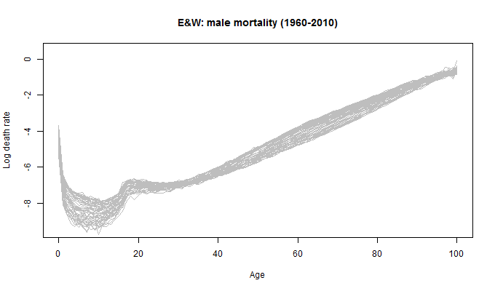
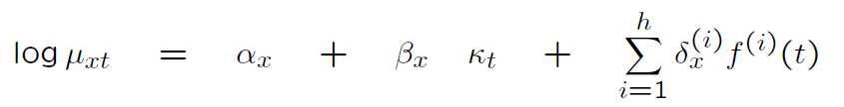
Modelling mortality Lee-Carter model

Slide 12

Modelling mortality Lee-Carter model

Slide 13

Modelling mortality Lee-Carter model

Slide 14

Modelling mortality Lee-Carter model

Slide 15
Modelling mortality Lee-Carter model in R
Package demography (Hyndman, 2012)
Implements several variants of the Lee-Carter model
Great for using data from the Human Mortality Data Base
Easy plotting of results and projection of mortality using package forecast
Not easily extendable
Implements the Lee-Carter models and other popular mortality models (Renshaw and Haberman (2006), APC, CBD and extensions)
Excel interface
Not easily extendable
LifeMetrics software (JP Morgan)
Package gnm (Turner and Firth, 2012)
General purpose package for fitting generalised non-linear models
Can be used to fit a large number of mortality models including the Lee-Carter model
Easily extendable (e.g cohort effects, multipopulation models, logit/binomial framework)

Slide 16




Modelling mortality Lee-Carter model with gnm
Lee Carter in a Poisson regression framework (Brouhns et al, 2002)

Slide 17
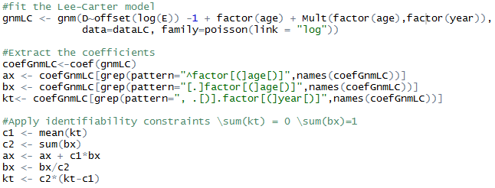
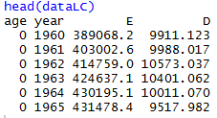
Modelling mortality Lee-Carter model with gnm
Lee Carter in a Poisson regression framework (Brouhns et al, 2002)

Slide 18
Modelling mortality Lee-Carter model with gnm
Lee Carter in a Poisson regression framework (Brouhns et al, 2002)

Slide 19
Modelling mortality Lee-Carter model with gnm
Lee Carter in a Poisson regression framework (Brouhns et al, 2002)

Slide 20
Modelling mortality Lee-Carter model with gnm
Lee Carter in a Poisson regression framework (Brouhns et al, 2002)

Slide 21
Modelling mortality Lee-Carter model with gnm
Lee Carter in a Poisson regression framework (Brouhns et al, 2002)

Slide 22
Modelling mortality Lee-Carter model with gnm
Lee Carter in a Poisson regression framework (Brouhns et al, 2002)

Slide 23
Modelling mortality Lee-Carter model with gnm
Lee Carter in a Poisson regression framework (Brouhns et al, 2002)

Slide 24
Modelling mortality Lee-Carter model with gnm
Lee Carter in a Poisson regression framework (Brouhns et al, 2002)

Slide 25
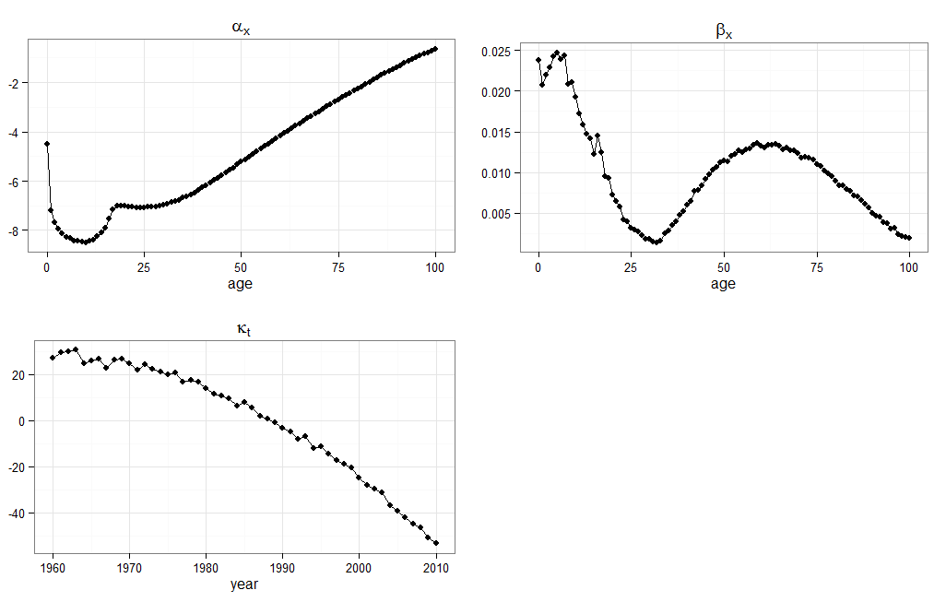
Modelling mortality Lee-Carter model with gnm (E&W males 1960-2010)
R tip
Use packages grid and gridExtra
For controlling the layout of graphics

Slide 26
Modelling mortality by cause of death Lee-Carter model with coding changes
Challenges
…
Changes in classification of causes of death difficult the analysis of trends
…

Slide 27
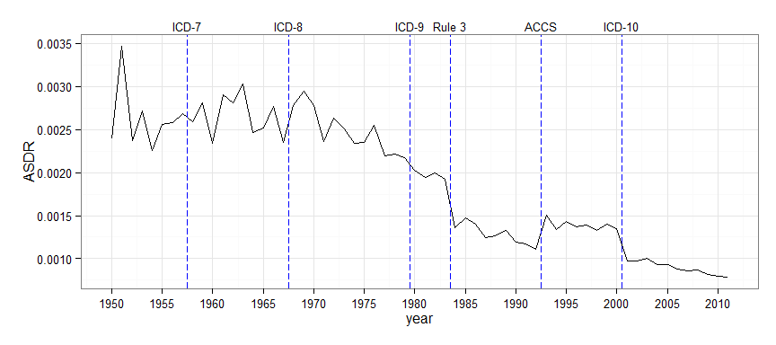
Modelling mortality by cause of death Lee-Carter model with coding changes
Challenges
…
Changes in classification of causes of death difficult the analysis of trends
…
Age-standardised mortality rate for respiratory diseases (Male age 25-84 – England and Wales)

Slide 28






Modelling mortality by cause of death Lee-Carter model with coding changes
Challenges
…
Changes in classification of causes of death difficult the analysis of trends
…

Slide 29




Modelling mortality by cause of death Lee-Carter model with coding changes
Challenges
…
Changes in classification of causes of death difficult the analysis of trends
…
Adjustment for coding changes

Slide 30
Modelling mortality by cause of death Lee-Carter model with coding changes
Challenges
…
Changes in classification of causes of death difficult the analysis of trends
…
Adjustment for coding changes
R implementation
This extension can be implemented using gnm combined with the package mgcv in order to ensure smoothness at the times of coding changes

Slide 31

Modelling by CoD and socio-economic stratification Three-way Lee-Carter model (Russolillo et al, 2011)

Slide 32
Modelling by CoD and socio-economic stratification Three-way Lee-Carter model (Russolillo et al, 2011)
Level differentials

Slide 33
Modelling by CoD and socio-economic stratification Three-way Lee-Carter model (Russolillo et al, 2011)
Level differentials
Improvement differentials

Slide 34
Modelling by CoD and socio-economic stratification Three-way Lee-Carter model (Russolillo et al, 2011)
Level differentials
Improvement differentials
R implementation
The standard three-way Lee-Carter and other multipopulation extensions of the Lee-Carter can be easily fitted using gnm
gnm(D~offset(log(E)) -1 + factor(age:sec) +
Mult(factor(age), factor(sec),factor(year)),.....)

Slide 35
Modelling by CoD and socio-economic stratification Three-way Lee-Carter model (Russolillo et al, 2011)
Level differentials
Improvement differentials
R implementation
The standard three-way Lee-Carter and other multipopulation extensions of the Lee-Carter can be easily fitted using gnm
gnm(D~offset(log(E)) -1 + factor(age:sec) +
Mult(factor(age), factor(sec),factor(year)),.....)

Slide 36
Modelling by CoD and socio-economic stratification Three-way Lee-Carter model (Russolillo et al, 2011)
Level differentials
Improvement differentials
R implementation
The standard three-way Lee-Carter and other multipopulation extensions of the Lee-Carter can be easily fitted using gnm
gnm(D~offset(log(E)) -1 + factor(age:sec) +
Mult(factor(age), factor(sec),factor(year)),.....)

Slide 37
Modelling by CoD and socio-economic stratification Three-way Lee-Carter model (Russolillo et al, 2011)
Level differentials
Improvement differentials
R implementation
The standard three-way Lee-Carter and other multipopulation extensions of the Lee-Carter can be easily fitted using gnm
gnm(D~offset(log(E)) -1 + factor(age:sec) +
Mult(factor(age), factor(sec),factor(year)),.....)
The three-way Lee-Carter with cause of death coding changes can be fitted with gnm in a two stage estimation procedure with a reference population

Slide 38
Case study: Mortality by deprivation in England Application data
Subpopulation data
Reference population data
England population disaggregated by IMD 2007 quintile
Ages: 25-29,30-34,…,80-84
Period: 1981-2007
England and Wales population asfdafasdfa sdfafd
Ages: 25-29,30-34,…,80-84
Period: 1960-2009

Slide 39
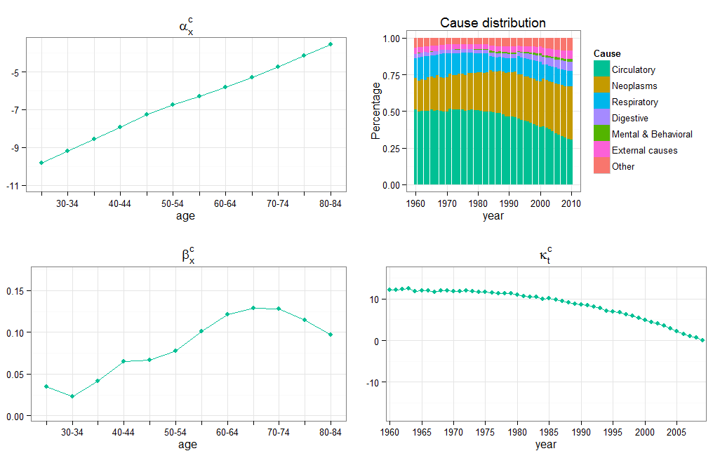
Case study: Mortality by deprivation in England England and Wales Male population parameters

Slide 40
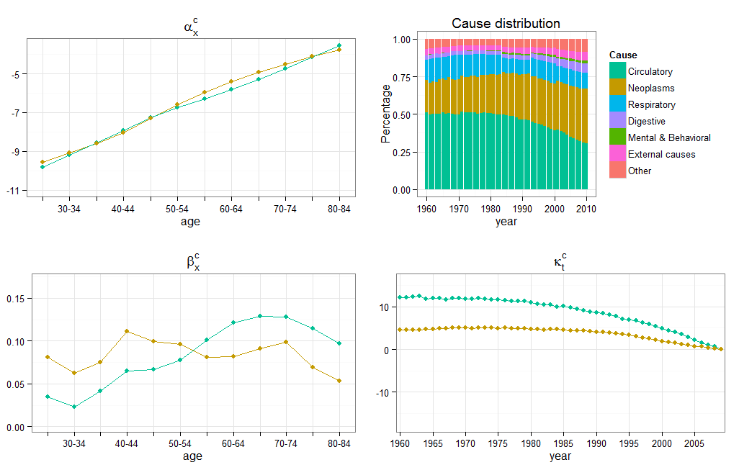
Case study: Mortality by deprivation in England England and Wales Male population parameters

Slide 41
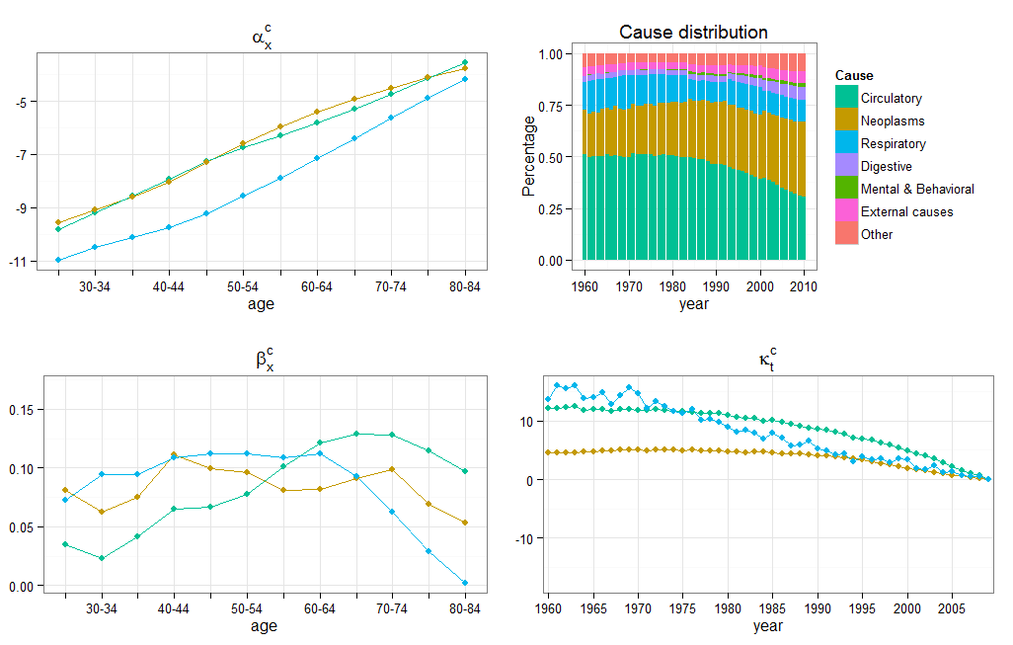
Case study: Mortality by deprivation in England England and Wales Male population parameters

Slide 42
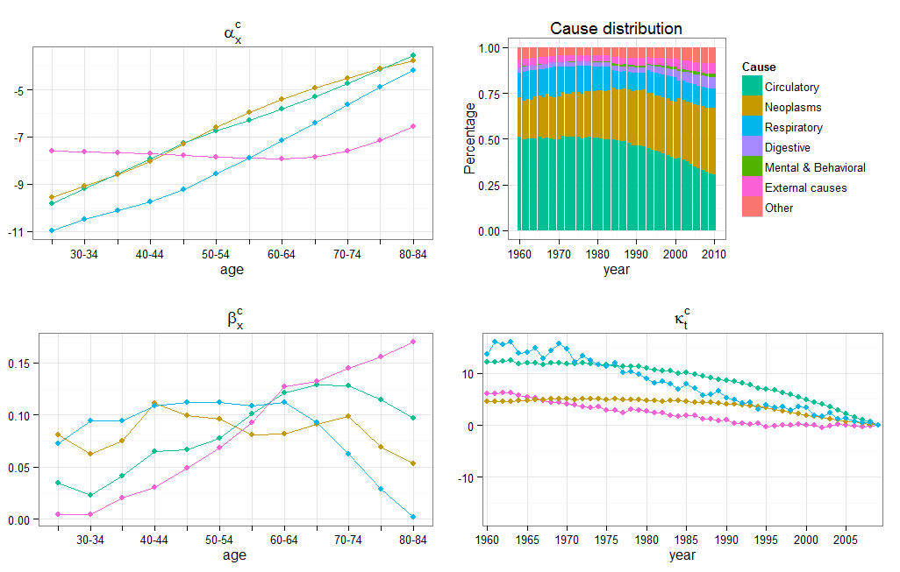
Case study: Mortality by deprivation in England England and Wales Male population parameters

Slide 43

Case study: Mortality by deprivation in England England and Wales Male population parameters

Slide 44
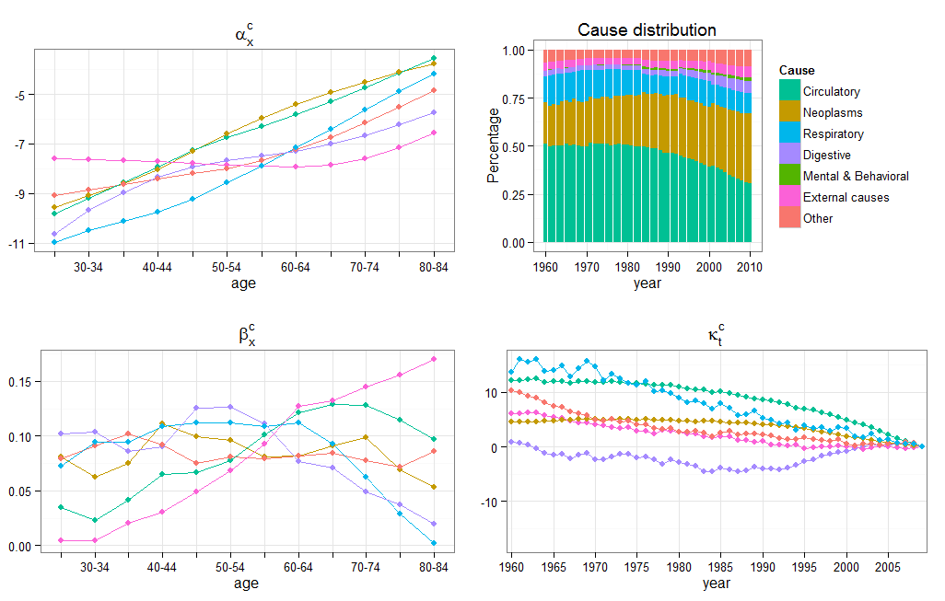
Case study: Mortality by deprivation in England England and Wales Male population parameters

Slide 45
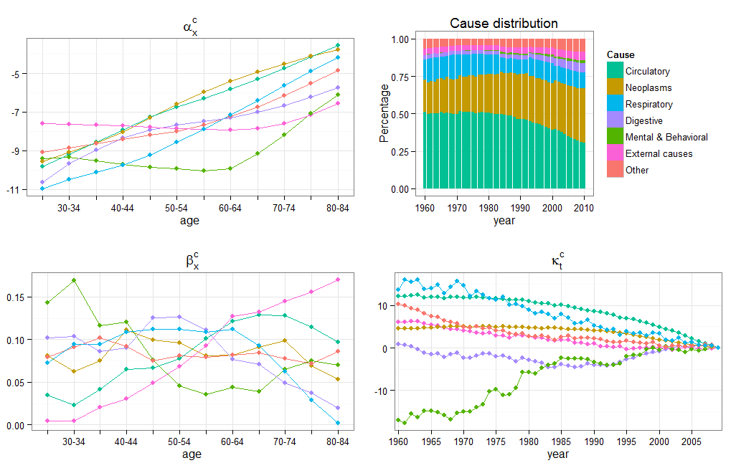
Case study: Mortality by deprivation in England England and Wales Male population parameters

Slide 46
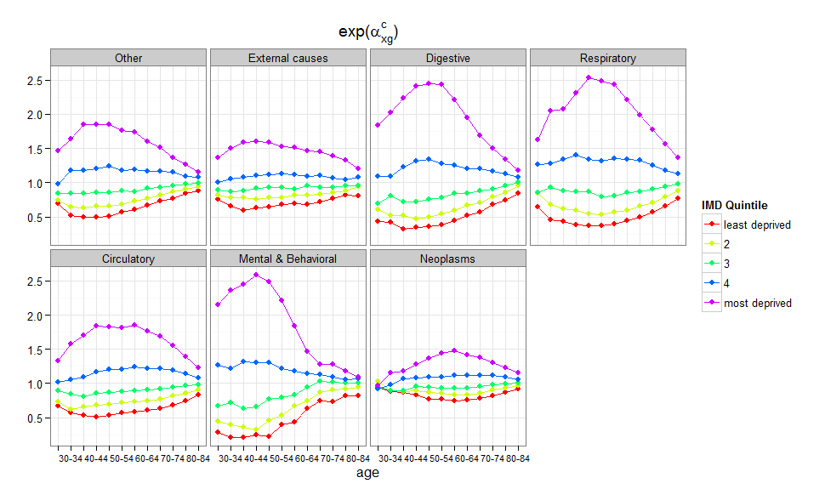
Case study: Mortality by deprivation in England Level differences by deprivation quintile
R tip
Use facet_wrap from ggplot2
to produce the same plot for different levels of a factor

Slide 47
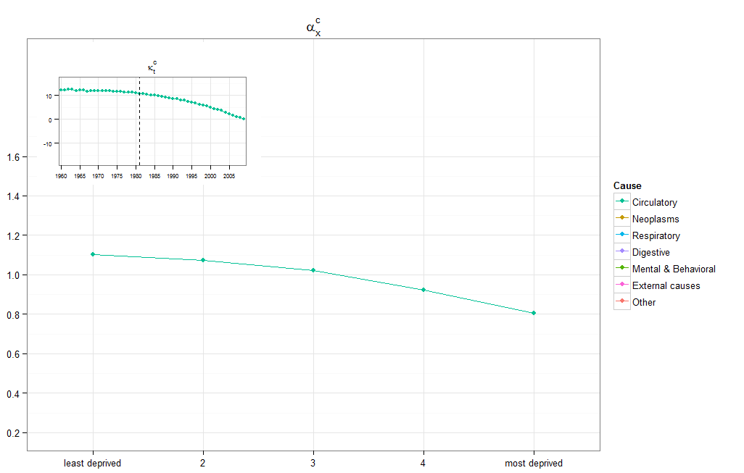
Case study: Mortality by deprivation in England Trend differences by deprivation quintile
R tip
Use function viewport in package grid to embed a miniature plot within a plot

Slide 48
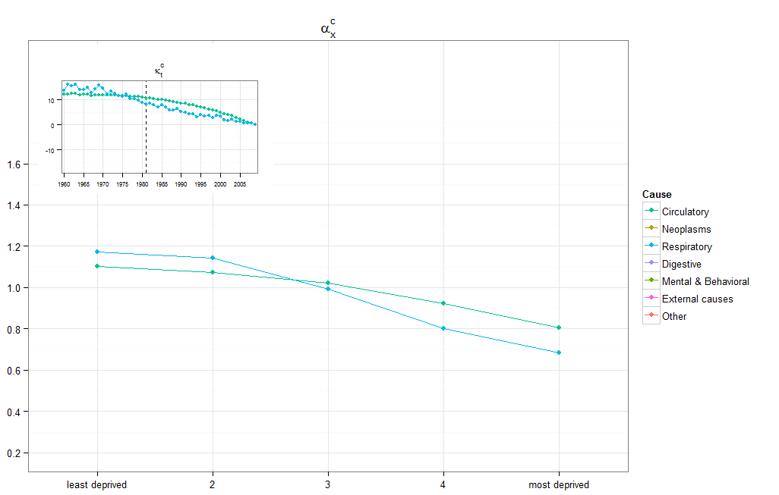
Case study: Mortality by deprivation in England Trend differences by deprivation quintile
R tip
Use function viewport in package grid to embed a miniature plot within a plot

Slide 49
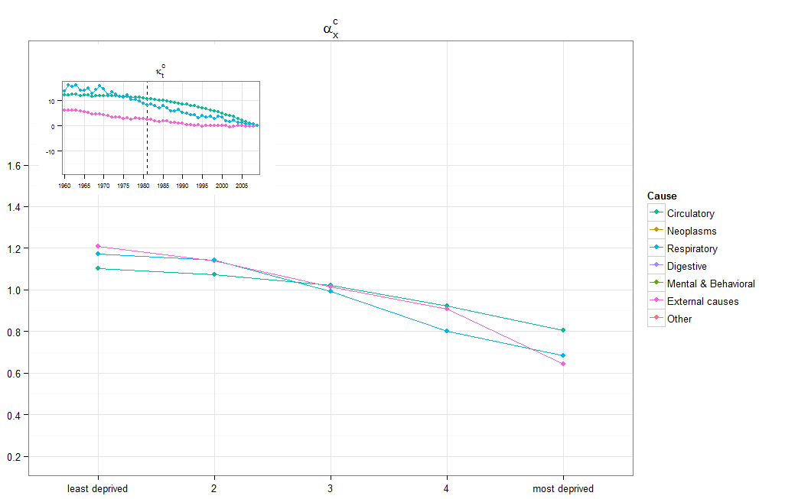
Case study: Mortality by deprivation in England Trend differences by deprivation quintile
R tip
Use function viewport in package grid to embed a miniature plot within a plot

Slide 50
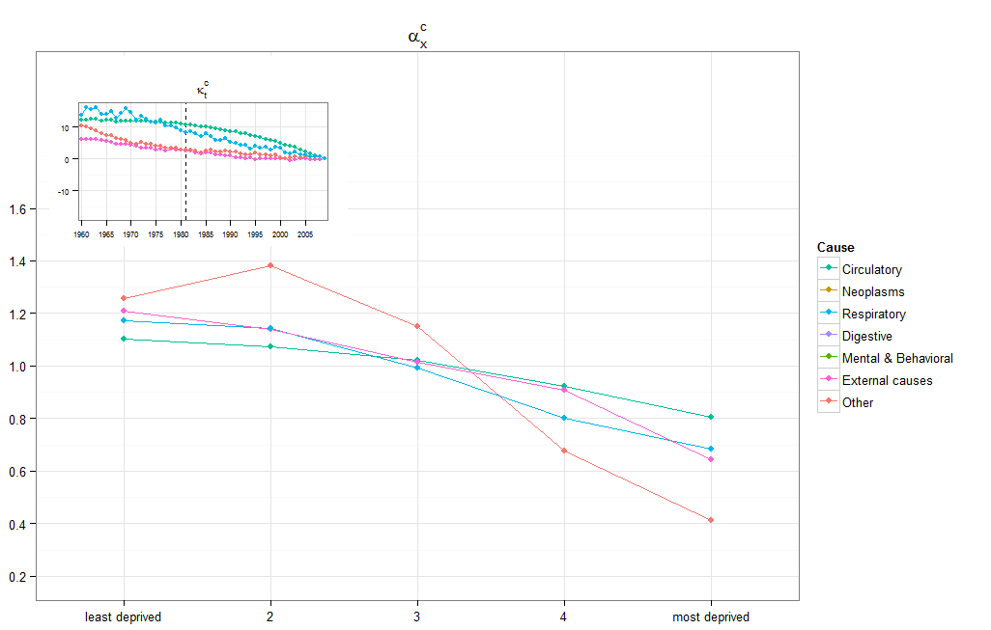
Case study: Mortality by deprivation in England Trend differences by deprivation quintile
R tip
Use function viewport in package grid to embed a miniature plot within a plot

Slide 51
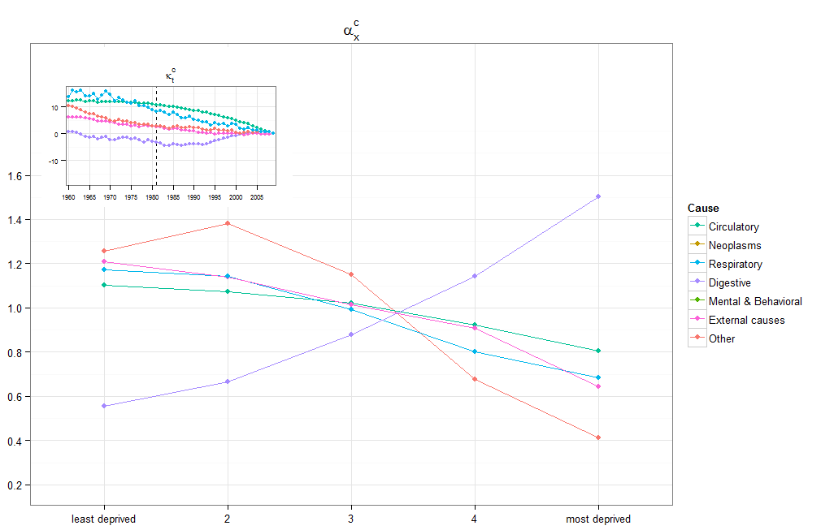
Case study: Mortality by deprivation in England Trend differences by deprivation quintile
R tip
Use function viewport in package grid to embed a miniature plot within a plot

Slide 52
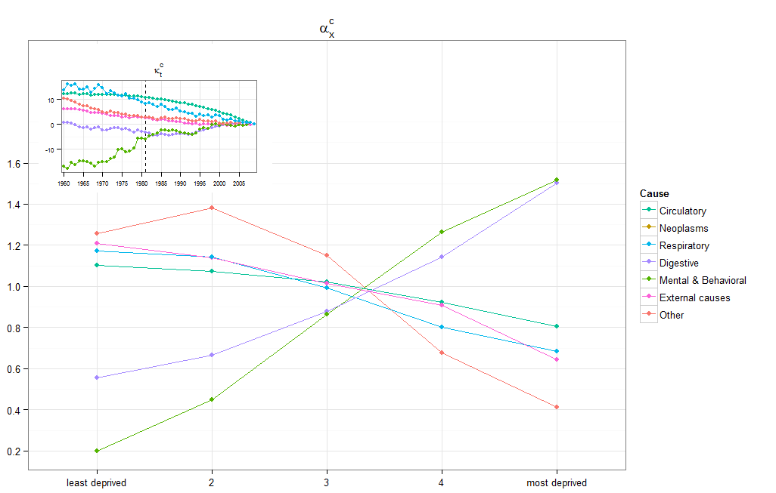
Case study: Mortality by deprivation in England Trend differences by deprivation quintile
R tip
Use function viewport in package grid to embed a miniature plot within a plot

Slide 53
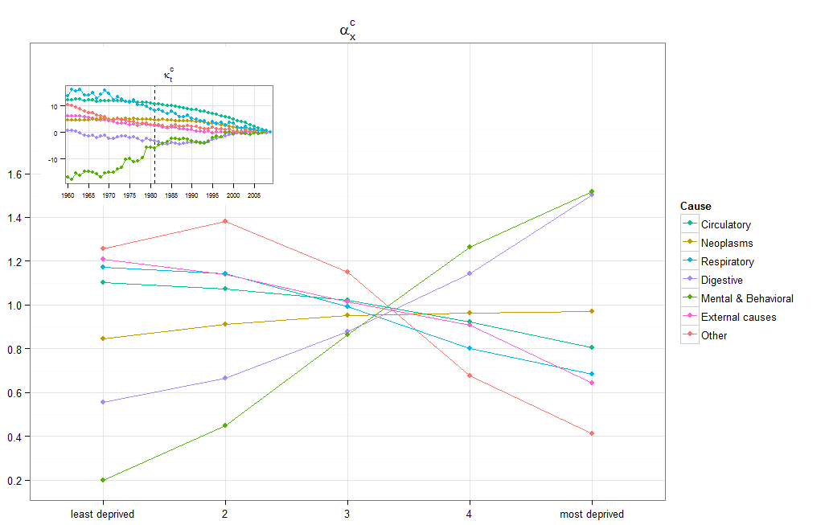
Case study: Mortality by deprivation in England Trend differences by deprivation quintile
R tip
Use function viewport in package grid to embed a miniature plot within a plot

Slide 54
Conclusions
R and in particular the package gnm are flexible tools for the fitting of
Standard mortality models including the Lee-Carter model
Complex extensions of the Lee-Carter model
R offers compelling tools for communicating modelling results
Application in the analysis of the extent of mortality differentials across deprivation subgroups in England for the period 1981- 2007
Clear inverse relationship between area deprivation and mortality for all causes
Reduction of differentials in cancer mortality
Offset of this reduction by marked differentials in digestive, respiratory and mental and behavioural diseases

Slide 55
Useful references
Turner, H., Firth, D., 2012. Generalized nonlinear models in R: an overview of the gnm package. (http://cran.r-project.org/web/packages/gnm/index.html)
Hyndman, R. J. (2012), demography: Forecasting mortality, fertility, migration and population data. with contributions from Heather Booth, Leonie Tickle and John Maindonald. (http://cran.r-project.org/web/packages/demography/index.html )
LifeMetrics (http://www.jpmorgan.com/pages/jpmorgan/investbk/solutions/lifemetrics/software)
Camarda, C. G. (2012), MortalitySmooth: An R package for smoothing Poisson counts with P-splines. Journal of Statistical Software 50(1), 1-24. (http://www.jstatsoft.org/v50/i01)
Package for fitting P-Splines to mortality data
Booth, Hyndman and Tickle (2013). Prospective life tables. In: Computational Actuarial Science with R. Edited by Arthur Charpentier (http://robjhyndman.com/chapters/prospective-life-tables/)
Examples of the use of packages demography, MortalitySmooth and LifeMetric functions
Charpentier , Dutang (2012) . Chapter 5 (Les tables prospectives) from L’Actuariat avec R. (http://cran.r-project.org/doc/contrib/Charpentier_Dutang_actuariat_avec_R.pdf)
Examples of the use of packages demography, gnm and LifeMetric functions
Wickham, H. (2009). ggplot2: elegant graphics for data analysis. Springer New York. (http://cran.r-project.org/web/packages/ggplot2/index.html)
Xie, Y. (2013). animation: An R Package for Creating Animations and Demonstrating Statistical Methods. Journal of Statistical Software 53(1), 1-27 (http://www.jstatsoft.org/v53/i01/paper)
http://robjhyndman.com/hyndsight/animations/: Rob Hyndman explanation of animations in R with an example for mortality data

